Slide 1
Unit 2 :
Relational ALGEBRA and SQL

Slide 2
What is an Algebra?
A language based on operators and a domain of values
Operators map values taken from the domain into other domain values
Hence, an expression involving operators and arguments produces a value in the domain
When the domain is a set of all relations (and the operators are as described later), we get the relational algebra
We refer to the expression as a query and the value produced as the query result

Slide 3
Relational ALGEBRA
Fundamental Relational-Algebra-Operations
Additional Relational-Algebra-Operations
Extended Relational-Algebra-Operations
Null Values
Modification of the Database

Slide 4
Relational Algebra in a DBMS
Optimized
Relational
algebra
expression
Relational
algebra
expression
Query
execution
plan
Executable
code
SQL
query
Code
generator
parser
Query optimizer
DBMS

Slide 5
Query Languages
Language in which user requests information from the database.
Categories of languages
  Procedural
  Non-procedural, or declarative
“Pure” languages:
  Relational algebra
  Tuple relational calculus
  Domain relational calculus
Pure languages form underlying basis of query languages that people use.

Slide 6
Relational Algebra
Procedural language
Six basic operators
  select: σ
  project: ∏
  union: ∪
  set difference: –
  Cartesian product: x
  rename: ρ
The operators take one or two relations as inputs and produce a new relation as a result.

Slide 7
Select Operator
Produce table containing subset of rows of argument table satisfying condition
σ_{condition} relation
Example:
Person σ_{Hobby=‘stamps’}(Person)
Id Name Address Hobby
Id Name Address Hobby
1123 John 123 Main stamps
1123 John 123 Main coins
5556 Mary 7 Lake Dr hiking
9876 Bart 5 Pine St stamps
1123 John 123 Main stamps
9876 Bart 5 Pine St stamps

Slide 8
Selection Condition
Operators: <, ≤, ≥, >, =, ≠
Simple selection condition:
  <attribute> operator <constant>
  <attribute> operator <attribute>
<condition> AND <condition>
<condition> OR <condition>
NOT <condition>

Slide 9
Selection Condition - Examples
σ _{Id>3000 Or Hobby=‘hiking’} (Person)
σ _{Id>3000 AND Id <3999} (Person)
σ _{NOT(Hobby=‘hiking’)} (Person)
σ _{Hobby≠‘hiking’} (Person)

Slide 10
Select Operation – Example
Relation r
A
B
C
D
α
α
β
β
α
β
β
β
1
5
12
23
7
7
3
10
σ_{A=B ^ D > 5} (r)
A
B
C
D
α
β
α
β
1
23
7
10

Slide 11
Project Operator
Produces table containing subset of columns of argument table
  Π_{attribute list}(relation)
Example:
  Person Π_{Name,Hobby}(Person)
Id Name Address Hobby Name Hobby
1123 John 123 Main stamps
1123 John 123 Main coins
5556 Mary 7 Lake Dr hiking
9876 Bart 5 Pine St stamps
John stamps
John coins
Mary hiking
Bart stamps

Slide 12
Project Operator
Example:
  Person Π_{Name,Address}(Person)
Id Name Address Hobby
Name Address
1123 John 123 Main stamps
1123 John 123 Main coins
5556 Mary 7 Lake Dr hiking
9876 Bart 5 Pine St stamps
John 123 Main
Mary 7 Lake Dr
Bart 5 Pine St
Result is a table (no duplicates)

Slide 13
Project Operation – Example
A
B
C
Relation r:
α
α
β
β
10
20
30
40
1
1
1
2
A
C
A
C
∏_{A,C} (r)
α
α
β
β
1
1
1
2
α
β
β
1
1
2
=

Slide 14
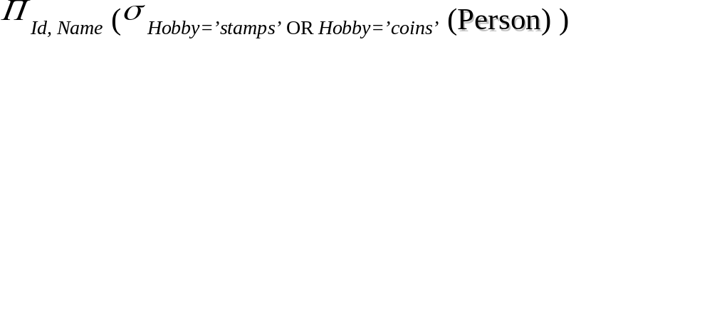
Expressions
Id Name Address Hobby Id Name
1123 John 123 Main stamps
1123 John 123 Main coins
5556 Mary 7 Lake Dr hiking
9876 Bart 5 Pine St stamps
1123 John
9876 Bart
Result
Person

Slide 15
Union Operation – Example
Relations r, s:
A
B
A
B
α
α
β
1
2
1
α
β
2
3
s
r
A
B
α
α
β
β
1
2
1
3
r ∪ s:

Slide 16
Set Difference Operation – Example
Relations r, s:
A
B
A
B
α
α
β
1
2
1
α
β
2
3
s
r
r – s:
A
B
α
β
1
1

Slide 17
Cartesian-Product Operation – Example
Relations r, s:
A
B
C
D
E
α
β
1
2
α
β
β
γ
10
10
20
10
a
a
b
b
r
s
r x s:
A
B
C
D
E
α
α
α
α
β
β
β
β
1
1
1
1
2
2
2
2
α
β
β
γ
α
β
β
γ
10
10
20
10
10
10
20
10
a
a
b
b
a
a
b
b

Slide 18

Rename Operation
Allows us to name, and therefore to refer to, the results of relational-algebra expressions.
Allows us to refer to a relation by more than one name.
Example:
ρ _{x} (E)
returns the expression E under the name X
If a relational-algebra expression E has arity n, then
returns the result of expression E under the name X, and with the
attributes renamed to A₁ , A₂ , …., A_{n} .

Slide 19
Composition of Operations
Can build expressions using multiple operations
Example: σ_{A=C}(r x s)
r x s
σ_{A=C}(r x s)
A
B
C
D
E
α
α
α
α
β
β
β
β
1
1
1
1
2
2
2
2
α
β
β
γ
α
β
β
γ
10
10
20
10
10
10
20
10
a
a
b
b
a
a
b
b
A
B
C
D
E
α
β
β
1
2
2
α
β
β
10
10
20
a
a
b

Slide 20
Banking Example
branch (branch_name, branch_city, assets)
customer (customer_name, customer_street, customer_city)
account (account_number, branch_name, balance)
loan (loan_number, branch_name, amount)
depositor (customer_name, account_number)
borrower (customer_name, loan_number)

Slide 21
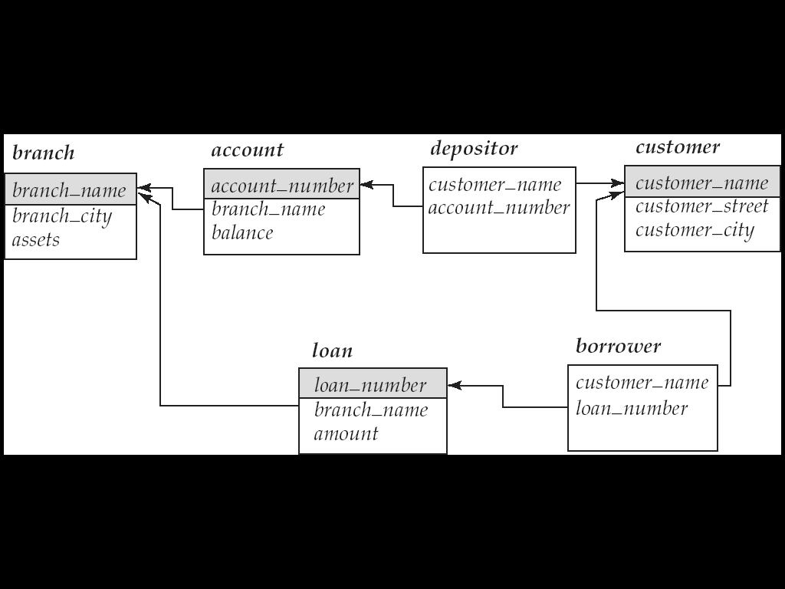
Example Queries
Find all loans of over $1200
σ_{amount > 1200} (loan)
Find the loan number for each loan of an amount greater than $1200
∏_{loan_number} (σ_{amount} _{> 1200} (loan))
Find the names of all customers who have a loan, an account, or both, from the bank
  ∏_{customer_name} (borrower) ∪ ∏_{customer_name} (depositor)

Slide 22
Example Queries
Find the names of all customers who have a loan at the Perryridge branch.
∏_{customer_name} (σ_{branch_name=“Perryridge”}
(σborrower.loan_number = loan.loan_number(borrower x loan)))
Find the names of all customers who have a loan at the
Perryridge branch but do not have an account at any branch of
the bank.
∏_{customer_name} (σ_{branch_name = “Perryridge”}
(σborrower.loan_number = loan.loan_number(borrower x loan))) –
∏_{customer_name}(depositor)

Slide 23
Example Queries
Find the names of all customers who have a loan at the Perryridge branch.
  ∏_{customer_name} (σ_{branch_name = “Perryridge”} (
  σborrower.loan_number = loan.loan_number (borrower x loan)))
  ∏_{customer_name}(σloan.loan_number = borrower.loan_number (
  (σ_{branch_name = “Perryridge”} (loan)) x borrower))

Slide 24
Additional Operations
Additional Operations
  Set intersection
  Natural join
  Aggregation
  Outer Join
  Division
All above, other than aggregation, can be expressed using basic operations we have seen earlier

Slide 25
Set-Intersection Operation – Example
Relation r, s:
r ∩ s
A B
A B
α
α
β
1
2
1
α
β
2
3
r
s
A B
α 2

Slide 26
Natural Join Operation – Example
Relations r, s:
A
B
C
D
B
D
E
α
β
γ
α
δ
1
2
4
1
2
α
γ
β
γ
β
a
a
b
a
b
1
3
1
2
3
a
a
a
b
b
α
β
γ
δ
∈
r
s
r s
A
B
C
D
E
α
α
α
α
δ
1
1
1
1
2
α
α
γ
γ
β
a
a
a
a
b
α
γ
α
γ
δ

Slide 27
Natural-Join Operation
Notation: r s
Let r and s be relations on schemas R and S respectively.
Then, r s is a relation on schema R ∪ S obtained as follows:
  Consider each pair of tuples t_{r} from r and t_{s} from s.
  If t_{r} and t_{s} have the same value on each of the attributes in R ∩ S, add a tuple t to the result, where
    t has the same value as t_{r} on r
    t has the same value as t_{s} on s
Example:
  R = (A, B, C, D)
  S = (E, B, D)
  Result schema = (A, B, C, D, E)
  r s is defined as:
  ∏_{r.A, r.B, r.C, r.D, s.E} (σ_{r.B = s.B} ∧ _{r.D = s.D} (r x s))

Slide 28
Bank Example Queries
Find the largest account balance
  Strategy:
    Find those balances that are not the largest
      Rename account relation as d so that we can compare each account balance with all others
    Use set difference to find those account balances that were not found in the earlier step.
  The query is:
∏_{balance}(account) - ∏_{account.balance}
(σ_{account.balance < d.balance} (account x ρ_{d} (account)))

Slide 29

Aggregate Functions and Operations
Aggregation function takes a collection of values and returns a single value as a result.
avg: average value
min: minimum value
max: maximum value
sum: sum of values
count: number of values
Aggregate operation in relational algebra
E is any relational-algebra expression
  G₁, G₂ …, G_{n} is a list of attributes on which to group (can be empty)
  Each F_{i} is an aggregate function
  Each A_{i} is an attribute name

Slide 30
Aggregate Operation – Example
Relation r:
A
B
C
α
α
β
β
α
β
β
β
7
7
3
10
g _{sum(c)} (r)
sum(c )
27
Question: Which aggregate operations cannot be expressed using basic relational operations?

Slide 31
Aggregate Operation – Example
Relation account grouped by branch-name:
branch_name
account_number
balance
Perryridge
Perryridge
Brighton
Brighton
Redwood
A-102
A-201
A-217
A-215
A-222
400
900
750
750
700
_{branch_name} g _{sum(balance)} (account)
branch_name
sum(balance)
Perryridge
Brighton
Redwood
1300
1500
700

Slide 32
Aggregate Functions (Cont.)
Result of aggregation does not have a name
  Can use rename operation to give it a name
  For convenience, we permit renaming as part of aggregate operation
_{branch_name} g _{sum(balance) as sum_balance} (account)

Slide 33
Outer Join
An extension of the join operation that avoids loss of information.
Computes the join and then adds tuples form one relation that does not match tuples in the other relation to the result of the join.
Uses null values:
  null signifies that the value is unknown or does not exist
  All comparisons involving null are (roughly speaking) false by definition.
    We shall study precise meaning of comparisons with nulls later

Slide 34
Outer Join – Example
Relation loan
loan_number
branch_name
amount
L-170
L-230
L-260
Downtown
Redwood
Perryridge
3000
4000
1700
Relation borrower
customer_name
loan_number
Jones
Smith
Hayes
L-170
L-230
L-155

Slide 35
Outer Join – Example
Join
loan borrower
loan_number
branch_name
amount
customer_name
L-170
L-230
Downtown
Redwood
3000
4000
Jones
Smith
Left Outer Join
loan borrower
loan_number
branch_name
amount
customer_name
L-170
L-230
L-260
Downtown
Redwood
Perryridge
3000
4000
1700
Jones
Smith
null

Slide 36
Outer Join – Example
Right Outer Join
loan borrower
loan_number
branch_name
amount
customer_name
L-170
L-230
L-155
Downtown
Redwood
null
3000
4000
null
Jones
Smith
Hayes
Full Outer Join
loan borrower
loan_number
branch_name
amount
customer_name
L-170
L-230
L-260
L-155
Downtown
Redwood
Perryridge
null
3000
4000
1700
null
Jones
Smith
null
Hayes
Question: can outerjoins be expressed using basic relational
algebra operations

Slide 37
Null Values
It is possible for tuples to have a null value, denoted by null, for some of their attributes
null signifies an unknown value or that a value does not exist.
The result of any arithmetic expression involving null is null.
Aggregate functions simply ignore null values (as in SQL)
For duplicate elimination and grouping, null is treated like any other value, and two nulls are assumed to be the same (as in SQL)

Slide 38
Null Values
Comparisons with null values return the special truth value: unknown
  If false was used instead of unknown, then not (A < 5)
  would not be equivalent to A >= 5
Three-valued logic using the truth value unknown:
  OR: (unknown or true) = true,
  (unknown or false) = unknown
  (unknown or unknown) = unknown
  AND: (true and unknown) = unknown,
  (false and unknown) = false,
  (unknown and unknown) = unknown
  NOT: (not unknown) = unknown
  In SQL “P is unknown” evaluates to true if predicate P evaluates to unknown
Result of select predicate is treated as false if it evaluates to unknown

Slide 39
Division Operation
r ÷ s
Notation:
Suited to queries that include the phrase “for all”.
Let r and s be relations on schemas R and S respectively where
  R = (A₁, …, A_{m} , B₁, …, B_{n} )
  S = (B₁, …, B_{n})
  The result of r ÷ s is a relation on schema
  R – S = (A₁, …, A_{m})
  r ÷ s = { t | t ∈ ∏ _{R-S} (r) ∧ ∀ u ∈ s ( tu ∈ r ) }
  Where tu means the concatenation of tuples t and u to produce a single tuple

Slide 40
Division Operation – Example
Relations r, s:
A
B
B
α
α
α
β
γ
δ
δ
δ
∈
∈
β
1
2
3
1
1
1
3
4
6
1
2
1
2
s
r ÷ s:
A
r
α
β

Slide 41
Another Division Example
Relations r, s:
A
B
C
D
E
D
E
α
α
α
β
β
γ
γ
γ
a
a
a
a
a
a
a
a
α
γ
γ
γ
γ
γ
γ
β
a
a
b
a
b
a
b
b
1
1
1
1
3
1
1
1
a
b
1
1
s
r
r ÷ s:
A
B
C
α
γ
a
a
γ
γ

Slide 42
Division Operation (Cont.)
Property
  Let q = r ÷ s
  Then q is the largest relation satisfying q x s ⊆ r
Definition in terms of the basic algebra operation
Let r(R) and s(S) be relations, and let S ⊆ R
r ÷ s = ∏_{R-S} (r ) – ∏_{R-S} ( ( ∏_{R-S} (r ) x s ) – ∏_{R-S,S}(r ))
To see why
  ∏_{R-S,S} (r) simply reorders attributes of r
  ∏_{R-S} (∏_{R-S} (r ) x s ) – ∏_{R-S,S}(r) ) gives those tuples t in
  ∏_{R-S} (r ) such that for some tuple u ∈ s, tu ∉ r.

Slide 43
Bank Example Queries
Find the names of all customers who have a loan and an account at bank.
  ∏_{customer_name} (borrower) ∩ ∏_{customer_name} (depositor)
Find the name of all customers who have a loan at the bank and the loan amount
  ∏customer_name, loan_number, amount (borrower loan)

Slide 44
Bank Example Queries
Find all customers who have an account from at least the “Downtown” and the Uptown” branches.
  Query 1
    ∏_{customer_name} (σ_{branch_name = “Downtown”} (depositor account )) ∩
    ∏_{customer_name} (σ_{branch_name = “Uptown”} (depositor account))
  Query 2
  ∏_{customer_name, branch_name} (depositor account)
  ÷ ρ_{temp(branch_name)} ({(“Downtown” ), (“Uptown” )})
  Note that Query 2 uses a constant relation.

Slide 45
Bank Example Queries
Find all customers who have an account at all branches located in Brooklyn city.
∏_{customer_name, branch_name} (depositor account)
÷ ∏_{branch_name} (σ_{branch_city = “Brooklyn”} (branch))

Slide 46
Formal Definition
A basic expression in the relational algebra consists of either one of the following:
  A relation in the database
  A constant relation
Let E₁ and E₂ be relational-algebra expressions; the following are all relational-algebra expressions:
  E₁ ∪ E₂
  E₁ – E₂
  E₁ x E₂
  σ_{p} (E₁), P is a predicate on attributes in E₁
  ∏_{s}(E₁), S is a list consisting of some of the attributes in E₁
  ρ _{x} (E₁), x is the new name for the result of E₁

Slide 47
Select Operation
Notation: σ _{p}(r)
p is called the selection predicate
Defined as:
σ_{p}(r) = {t | t ∈ r and p(t)}
Where p is a formula in propositional calculus consisting of terms connected by : ∧ (and), ∨ (or), ¬ (not)
Each term is one of:
<attribute> op <attribute> or <constant>
where op is one of: =, ≠, >, ≥. <. ≤
Example of selection:
σ _{branch_name=“Perryridge”}(account)

Slide 48

Project Operation
Notation:
where A₁, A₂ are attribute names and r is a relation name.
The result is defined as the relation of k columns obtained by erasing the columns that are not listed
Duplicate rows removed from result, since relations are sets
Example: To eliminate the branch_name attribute of account
∏_{account_number, balance} (account)

Slide 49
Union Operation
Notation: r ∪ s
Defined as:
r ∪ s = {t | t ∈ r or t ∈ s}
For r ∪ s to be valid.
1. r, s must have the same arity (same number of attributes)
2. The attribute domains must be compatible (example: 2nd column
of r deals with the same type of values as does the 2nd
column of s)
Example: to find all customers with either an account or a loan
∏_{customer_name} (depositor) ∪ ∏_{customer_name} (borrower)

Slide 50
Set Difference Operation
Notation r – s
Defined as:
r – s = {t | t ∈ r and t ∉ s}
Set differences must be taken between compatible relations.
  r and s must have the same arity
  attribute domains of r and s must be compatible

Slide 51
Cartesian-Product Operation
Notation r x s
Defined as:
r x s = {t q | t ∈ r and q ∈ s}
Assume that attributes of r(R) and s(S) are disjoint. (That is, R ∩ S = ∅).
If attributes of r and s are not disjoint, then renaming must be used.

Slide 52
Set-Intersection Operation
Notation: r ∩ s
Defined as:
r ∩ s = { t | t ∈ r and t ∈ s }
Assume:
  r, s have the same arity
  attributes of r and s are compatible
Note: r ∩ s = r – (r – s)

